Slide 1


K.RAMAKRISHNAN COLLEGE OF TECHNOLOGY
(AUTONOMOUS), TRICHY
EMPLOYEE PAYROLL MANAGEMENT SYSTEM
PRESENTED BY SUPERVISOR
MAADHAV B Mrs.K.Valli Priyadharshini M.E., (PhD),
2303811710421086 AP/CSE.

Slide 2
PRESENTATION OVERVIEW
Objective
Project Introduction
Problem Statement
Methodologies (Programming concepts relevant to problem statement)
Architecture of the proposed system
List of Modules
7. Merits
8. Results and Discussion
9. Queries

Slide 3
OBJECTIVE
The objective of this project is to design and implement a user-friendly system that automates payroll management, providing functionalities to store employee details, calculate net salaries, generate payroll reports, and display information efficiently. It aims to reduce manual errors, improve accuracy, and streamline the payroll process for small-scale organizations.

Slide 4
PROJECT INTRODUCTION
The EPMS project focuses on automating and managing payroll operations to eliminate manual errors, enhance productivity, and provide timely, accurate payroll processing. The system supports key features such as automated calculations, tax computations, employee records management, and report generation.

Slide 5
PROBLEM STATEMENT
Managing employee payroll manually can be tedious, time-consuming, and prone to errors. Tasks like calculating net salaries, generating reports, and maintaining employee records often lead to inefficiencies, especially in organizations with growing staff. This project addresses these challenges by providing an automated solution to handle payroll operations effectively.

Slide 6
METHODOLOGIES
Object-Oriented Programming (OOP)
The system uses OOP principles to organize functionalities into modular, reusable, and scalable components. Key features like encapsulation ensure data integrity within the Employee class, while inheritance is demonstrated by extending the Frame class for GUI functionality. Polymorphism is employed through method overriding, such as customizing the toString() method for meaningful employee representation.
Java Collections Framework
An ArrayList is used to dynamically store and manage employee records. This data structure provides flexibility to add, remove, or search employees efficiently, making it suitable for handling a variable number of records.

Slide 7
METHODOLOGIES
AWT (Abstract Window Toolkit)
The GUI is designed using AWT components like Label, TextField, Button, and TextArea, creating an interactive interface. Event handling with ActionListener allows the program to respond to user actions like button clicks, enhancing usability.
Exception Handling
Robust error management is implemented using try-catch blocks to handle invalid inputs gracefully, such as non-numeric data for employee IDs or salaries. This prevents application crashes and ensures a smooth user experience.

Slide 8




ARCHITECTURE DIAGRAM
USER INPUT
Save Employee Data
Add Employee
Generate Payroll
Calculate &
Salary reduction
Display Result
Fetch Employee
Data
Search Employee

Slide 9
LIST OF MODULES
Employee Management Module: Manages employee records by adding, retrieving, and storing data.
Payroll Calculation Module: Computes net salaries based on basic salary, deductions, and bonuses.
Report Generation Module: Prepares and displays payroll reports summarizing employee details and net salaries.
GUI Module: Provides an interactive interface for data input, processing actions, and result visualization.

Slide 10
MERITS
· Automates payroll management, reducing manual effort.
· Improves accuracy in salary calculations and report generation.
· Provides a user-friendly interface for easy operation.
· Modular design allows for scalability and future enhancements.
· Error handling ensures robust and seamless operation.

Slide 11
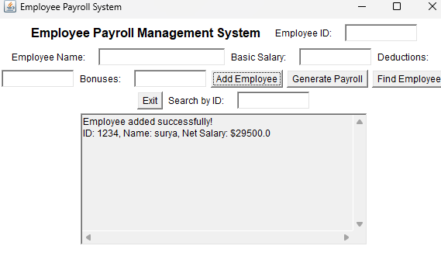
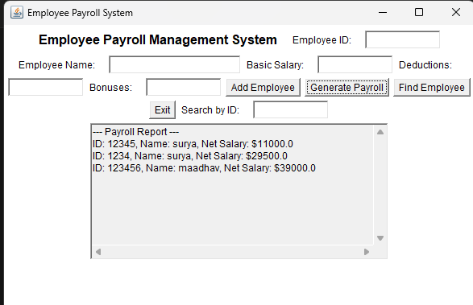
RESULTS AND DISCUSSION
ADD EMPLOYEE
PAYROLL GENERATION

Slide 12
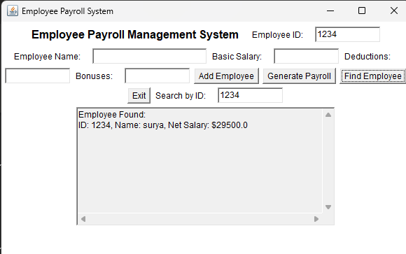
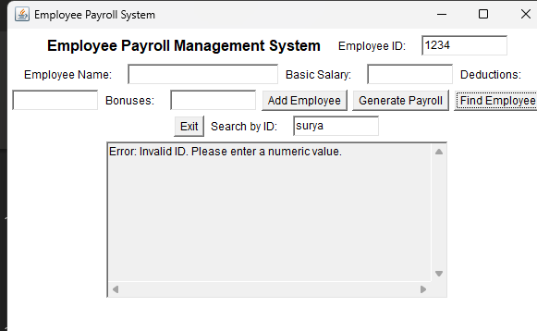
RESULTS AND DISCUSSION
FOUND EMPLOYEE
INVALID INPUT

Slide 13
QUERIES!

